Slide 1
Weekly Report
skyforce / RSEE4
2010/10/08

Slide 2
CCTv3 Improvement Research - Status
Progress
AUO 11307 Platform 9/27~10/15
Color engine toolkit integrated 10/4~10/8
Problem
UI移植
Future Plan
AUO 11307 Platform 9/27~10/15
Adjust verification 10/11~10/15
Auto Adjust Color Database 10/18~11/05
Luminance Mapping 10/18~10/19
Auto toolkit 10/20~10/26
Color Database 10/27~11/2
SOP 11/3~11/05
Dim Grey Fix: Find Reasonable Target White 11/08~12/24
Meet CCT criteria 11/08~11/19
Meet eye inspect 11/22~12/17
Workbook 12/20~12/24

Slide 3

Hue Toolkit Update
Purpose
工欲善其事必先利其器
新增功能
更多Pattern的選擇
可由選擇的色相自動產生Pattern, 作為調整參考
Saturation & Value的選擇
HSV為指定式調整, 更為直覺
與常用繪圖軟體調整方式相同
Hue的調整範圍為$±$45度
HSV對照表的內插產生
可由6筆60°的資訊, 內插出其餘18筆
再由6筆60°+6筆30° , 內插出其餘12筆

Slide 4
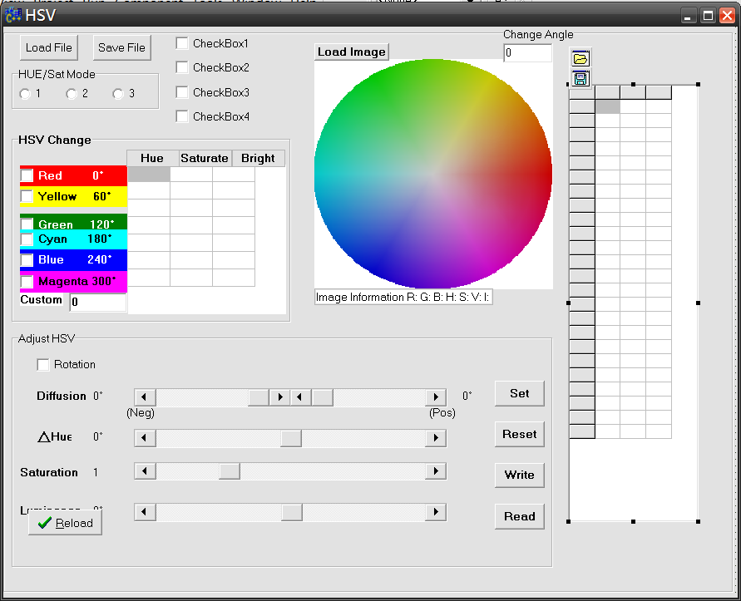
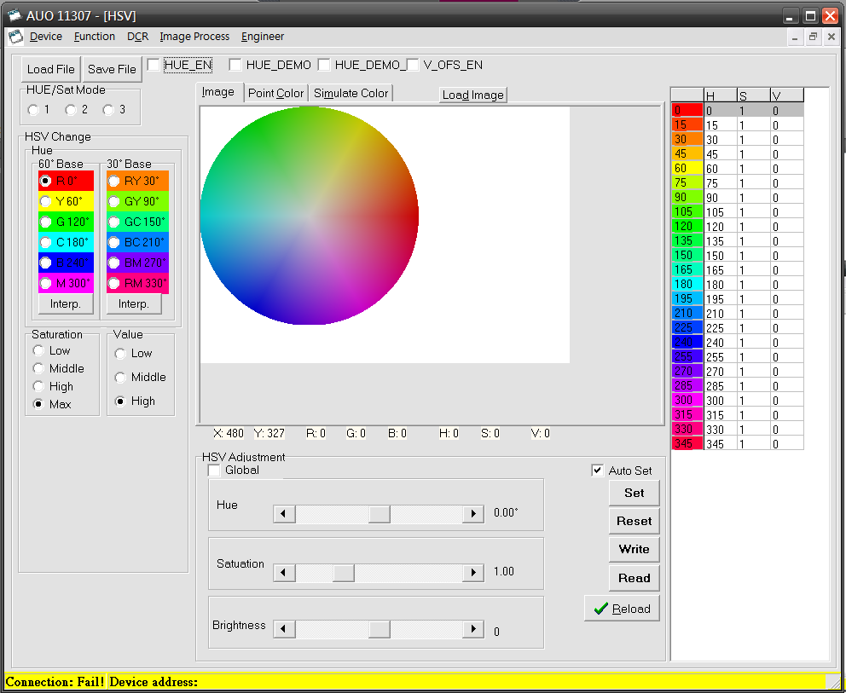

選擇色相後自動產生Pattern
Pattern同步顯示
Hue選擇及內插
Saturation & Value的選擇
HSV皆為指定式調整而非累積式
Hue的調整範圍為$±$45度

Slide 5
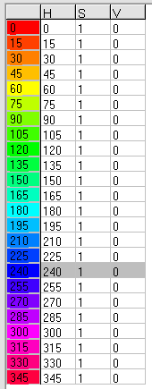
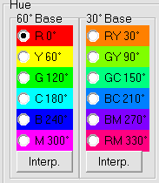
Interpolation from 60 ° Base
HUE LUT
Interpolation from 30 ° Base
HUE LUT

Slide 6
 |  |  |  | 2010 Sep |  |  |  | 2010 Oct |  |  |  | 2010 Oct
List | Item | Start | End | 9/6 | 9/13 | 9/20 | 9/27 | 10/4 | 10/11 | 10/18 | 10/25 | 11/1 | 11/8 | 11/15 | 11/22
CCTv3 | 下視角亮度差
 | Dim Grey Fix | 11/8 | 12/24
 | -低灰階異色threshold實驗 | 11/8 | 11/19
 | -最適Dim Target White自動產生 | 11/22 | 12/17
 | -Workbook | 12/20 | 12/24
 | Non-stable CCT (B116XW03)
 | -面板特性解析
AUO-11307 Platform | HSV manual-adjustment revised | 9/27 | 10/1
 | color engine toolkit integrated | 10/4 | 10/8
 | Sharpness/CM/HSV/CCT verification | 10/11 | 10/15
Color Database | color engine auto-toolkit | 9/20 | 10/8
 | -gamut mapping | 10/18 | 10/19
 | -embedded in CM/HSV auto-toolkit | 10/20 | 10/26
 | color database | 10/27 | 11/2
 | color engine SOP | 11/3 | 11/5

